Slide 1
OVERVIEW OF OSMOREGULATION IN ANIMALS.
GROUP 29

Slide 2
OUTLINE
Introduction
Types of Osmoregulation
Osmoregulation in Mammals
Adaptation to terrestrial, marine, and desert environments
Advantages and Disadvantages of osmoregulation in Mammals
Osmoregulation in Fish: freshwater and seawater habitats
Conclusion
Reference

Slide 3
INTRODUCTION
Osmoregulation is the process of maintaining salt and water balance (osmotic balance) within the body.
The fluids inside and surrounding cells compose of water, electrolytes, and nonelectrolytes.

Slide 4
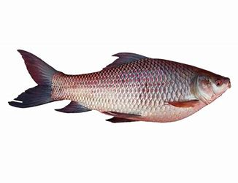
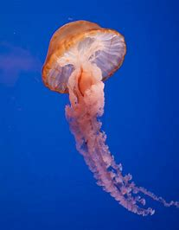
TYPES OF OSMOREGULATION
There are two major types:
Osmoregulators: An example is the beluga.
Osmoconformers: An example is the jellyfish.

Slide 5
OSMOREGULATION IN MAMMALS.
Osmoregulation is complex in mammals, and possess tightly regulated processes that ensure osmotic balance. Below are certain mechanisms:
KIDNEY MECHANISM.
Kidneys are primary organs in osmoregulation. They filter blood to remove waste products, excess ions, and water.
Blood is filtered through the glomerulus, and the filtrate which contains water, ions, and waste products enters the renal tubules.

Slide 6
OSMOREGULATION IN MAMMALS CONT’D.
As the filtrate passes through the renal tubules, glucose, amino acids, and most of the filtered water are reabsorbed into the bloodstream, maintaining a stable internal environment.
In the distal tubule and collecting duct, filtrate concentration is adjusted based on the body’s needs.
.

Slide 7
OSMOREGULATION IN MAMMALS CONT’D.
Hormones like ADH play a vital role in regulating the permeability of the collecting duct. Thus, influencing the amount of water reabsorbed, and consequently, urine concentration.

Slide 8
OSMOREGULATION IN MAMMALS CONT’D.
THIRST REGULATION.
Mammals detect their water intake through thirst.
A decrease in water levels signals the brain, triggering the sensation of thirst, thus, prompting intake of water.

Slide 9
OSMOREGULATION IN MAMMALS CONT’D.
SWEATING.
When body temperature rises, heat is dissipated through evaporative cooling.
However, water is lost in this process which is compensated by increased water intake.

Slide 10
OSMOREGULATION IN MAMMALS CONT’D.
HORMONAL REGULATION.
Hormones such as aldosterone and renin-angiotensin-aldosterone system (RAAS) are involved in regulating electrolyte and water balance, in response to changes in blood pressure and volume.

Slide 11
OSMOREGULATION IN MAMMALS CONT’D.
SALIVARY GLANDS
Kangaroos and koalas have specialized salivary glands that help in excreting excess salt.
GILLS
Some aquatic mammals like whales and dolphins, have specialized gills to extract oxygen from water and excrete excess salt.

Slide 12
ADAPTATION TO TERRESTRIAL, MARINE, AND DESERT ENVIRONMENTS
TERRESTRIAL MAMMALS.
Rodents and carnivores face challenges in conserving water due to their living conditions.

Slide 13
ADAPTATION TO TERRESTRIAL, MARINE, AND DESERT ENVIRONMENTS CONT’D.
They excrete nitrogenous waste as urea, reabsorb water with their kidneys to prevent excessive loss.
They obtain water primarily from their diet and metabolic processes.

Slide 14
ADAPTATION TO TERRESTRIAL, MARINE, AND DESERT ENVIRONMENTS CONT’D.
MARINE MAMMALS
Seals, whales, and dolphins possess efficient kidneys for excretion of concentrated urine, thus, minimizing water loss.

Slide 15
ADAPTATION TO TERRESTRIAL, MARINE, AND DESERT ENVIRONMENTS CONT’D.
They obtain water from their prey.
Possess specialized tissues and efficient electrolyte regulation, to tolerate high salt concentrations.

Slide 16
ADAPTATION TO TERRESTRIAL, MARINE, AND DESERT ENVIRONMENTS CONT’D.
DESERT MAMMALS
Camels can tolerate significant dehydration by reducing water loss, through their urine and feces.
Kangaroo rats produce highly concentrated urine, and can conserve water through metabolic adaptations.

Slide 17
ADVANTAGES AND DISADVANTAGES OF OSMOREGULATION IN MAMMALS.
Advantages:
Maintaining cellular function
Adapting to different environments
Preventing dehydration
Removing waste products

Slide 18
ADVANTAGES AND DISADVANTAGES OF OSMOREGULATION IN MAMMALS CONT’D.
Disadvantages:
Energy expenditure
Adaptation
Limited resources

Slide 19
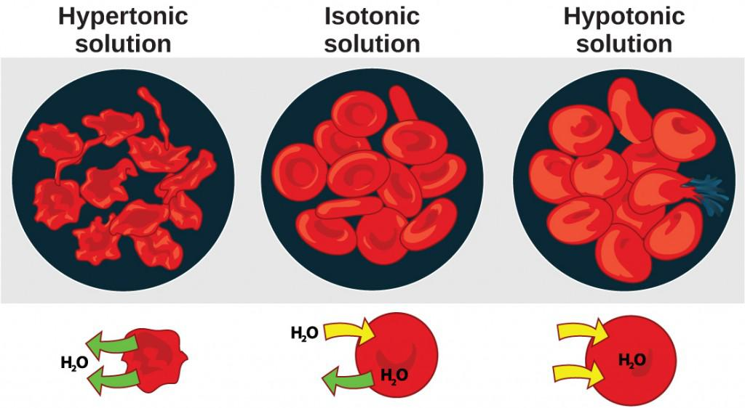
OSMOREGULATION IN FISH.
Cells placed in a hypertonic environment tend to shrink due to loss of water. In a hypotonic environment, cells tend to swell due to the intake of water. The blood maintains an isotonic environment so that cells neither shrink nor swell. (Credit: Mariana Ruiz Villareal)

Slide 20
Freshwater Fish And Marine Fish.
Freshwater Fish
Marine Fish
Live in hypotonic conditions.
Possess specialized ion transport in in the gills, active reabsorption of ions in kidneys, and production of large volumes of dilute urine to remove excess water.
Live in hypertonic conditions.
They drink seawater, actively absorb salts in the intestines, and excrete excess salts through their gills and kidneys.
Production of concentrated urine to conserve water.

Slide 21
CONCLUSION.
Animals are constantly in contact with the environment, exchanging water and nutrients through food and water consumption, as well as excretion in the form of sweat, urine, and feces.
A breakdown in a mechanism may be fatal, indicating that, osmoregulation is an essential part of animal survival.

Slide 22
REFERENCE.
Concepts of Biology-1st Canadian Edition open textbook by Charles Molnar and Jane Gair (Chapter 11- Homeostasis and Osmoreguation).

Slide 23
GROUP MEMBERS.
Harriet Appiah Serwaa Bonsu- 9201319
Mahama Abdul-Hakim Borenyi- 9212019
Perpetual Nana Osei- 9216019
Koomson Kingsley- 9211119
Sackey Gideon Ansah- 9218319
Amissah Firdaus- 9198519

Slide 24
THANK YOU!

